Slide 1
Digital Logic & Design
Lecture 09

Slide 2
Recap
Commutative, Associative and Distributive Laws
Rules
Demorgan’s Theorems

Slide 3
Recap
Boolean Analysis of Logic Circuits
Simplification of Boolean Expressions
Standard form of Boolean expressions

Slide 4
Examples
Boolean Analysis of Circuit
Evaluating Boolean Expression
Representing results in a Truth Table
Simplification of Boolean Expression into SOP or POS form
Representing results in a Truth Table
Verifying two expressions through truth tables

Slide 5
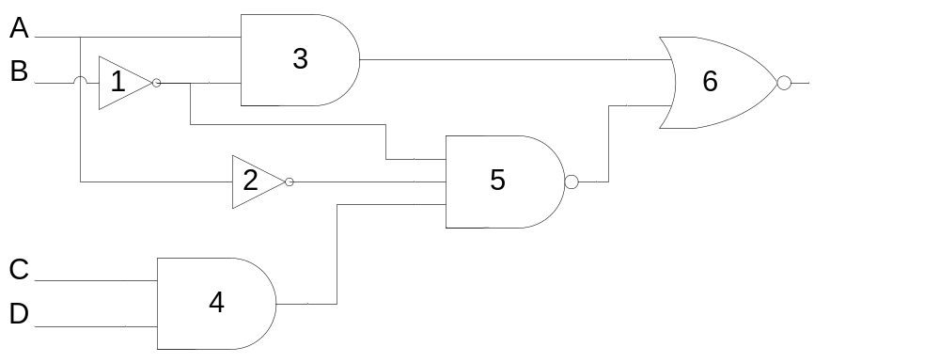
Analysis of Logic Circuits Example 1
Notes:
Consider the logic circuit comprising of NOT gates, AND gates, NAND gate and NOR gate.
The circuit can be represented by a Boolean Expression
Let us define the Boolean expression that represents the Logic circuit.
Starting from the left hand side of the circuit
Output of NOT gate 1 is B*
Output of NOT gate 2 is A*
Output of two input AND gate 3 is AB*
Output of two input AND gate 4 is CD
Output of three input NAND gate 5 is (A*B*CD)*
Output of two input NOR gate 6 is (AB*+(A*B*CD)*)*

Slide 6
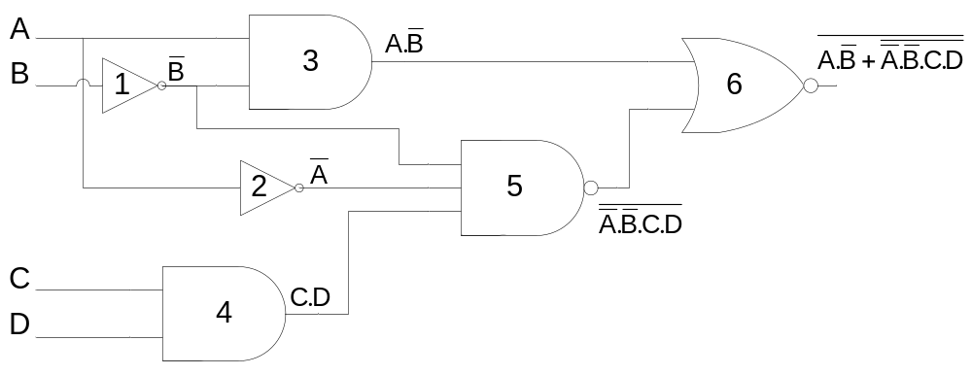
Analysis of Logic Circuits Example 1
Notes:
Consider the logic circuit comprising of NOT gates, AND gates, NAND gate and NOR gate.
The circuit can be represented by a Boolean Expression
Let us define the Boolean expression that represents the Logic circuit.
Starting from the left hand side of the circuit
Output of NOT gate 1 is B*
Output of NOT gate 2 is A*
Output of two input AND gate 3 is AB*
Output of two input AND gate 4 is CD
Output of three input NAND gate 5 is (A*B*CD)*
Output of two input NOR gate 6 is (AB*+(A*B*CD)*)*

Slide 7
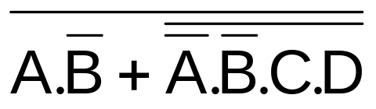
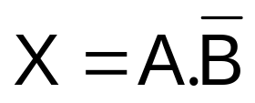
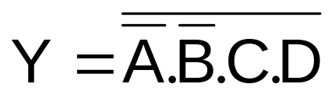
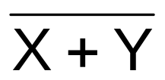
Evaluating Boolean Expression
The expression
Assume and
Expression
Conditions for output = 1 X=0 & Y=0
Since X=0 when A=0 or B=1
Since
Y=0 when A=0, B=0, C=1 and D=1
Notes:
Now consider the expression which has two terms
The term AB* and the term (A*B*CD)*
Assume that the term AB* is represented by literal X
Also assume that the term (A*B*CD)*is represented by the literal Y
Thus the expression is now represented as (X+Y)*
For which condition does the expression output a 1?
The expression shows that a NOR operation is being performed between terms X and Y.
Therefore when terms X and Y are both 0s only then the output is a 1.
The term X=AB* is 0 when literal A is 0 or literal B* is zero or B is 1.
The term Y=(A*B*CD)* is 0 when the term A*B*CD =1 the bar has been removed.
The term A*B*CD is 1 when literals A*=1, B*=1, C=1 and D=1
Or when A=0, B=0, C=1 and D=1

Slide 8
Evaluating Boolean Expression & Truth Table
Input |  |  |  | Output
A | B | C | D | F
0 | 0 | 0 | 0
0 | 0 | 0 | 1
0 | 0 | 1 | 0
0 | 0 | 1 | 1
0 | 1 | 0 | 0
0 | 1 | 0 | 1
0 | 1 | 1 | 0
0 | 1 | 1 | 1
1 | 0 | 0 | 0
1 | 0 | 0 | 1
1 | 0 | 1 | 0
1 | 0 | 1 | 1
1 | 1 | 0 | 0
1 | 1 | 0 | 1
1 | 1 | 1 | 0
1 | 1 | 1 | 1
Conditions for o/p =1
A=0, B=0, C=1 & D=1
Notes:
Conditions for output =1 are
For the term AB* A=0 OR B=1
For the term (A*B*CD)* A=0 AND B=0 AND C=1 AND D=1
For both terms A has to be 0 otherwise the output is not equal to 1
B has to be 0 otherwise the second term is equal to 1 and the output 0
Similarly C and D variables have to be equal to 1s otherwise the second term is equal to 1 and the output 0
The truth table describes the function of the logic circuit and the expression where all outputs are equal to 0 except for the input combination of A=0, B=0, C=1 & D=1

Slide 9
Evaluating Boolean Expression & Truth Table
Conditions for o/p =1
A=0, B=0, C=1 & D=1
Input |  |  |  | Output
A | B | C | D | F
0 | 0 | 0 | 0 | 0
0 | 0 | 0 | 1 | 0
0 | 0 | 1 | 0 | 0
0 | 0 | 1 | 1 | 1
0 | 1 | 0 | 0 | 0
0 | 1 | 0 | 1 | 0
0 | 1 | 1 | 0 | 0
0 | 1 | 1 | 1 | 0
1 | 0 | 0 | 0 | 0
1 | 0 | 0 | 1 | 0
1 | 0 | 1 | 0 | 0
1 | 0 | 1 | 1 | 0
1 | 1 | 0 | 0 | 0
1 | 1 | 0 | 1 | 0
1 | 1 | 1 | 0 | 0
1 | 1 | 1 | 1 | 0
Notes:
Conditions for output =1 are
For the term AB* A=0 OR B=1
For the term (A*B*CD)* A=0 AND B=0 AND C=1 AND D=1
For both terms A has to be 0 otherwise the output is not equal to 1
B has to be 0 otherwise the second term is equal to 1 and the output 0
Similarly C and D variables have to be equal to 1s otherwise the second term is equal to 1 and the output 0
The truth table describes the function of the logic circuit and the expression where all outputs are equal to 0 except for the input combination of A=0, B=0, C=1 & D=1

Slide 10
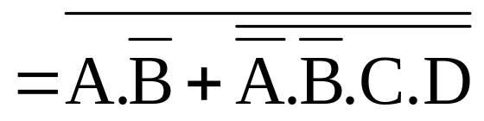
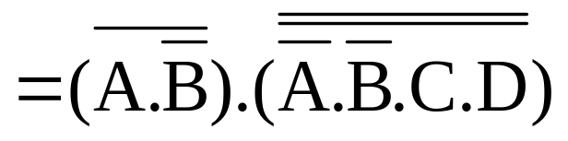
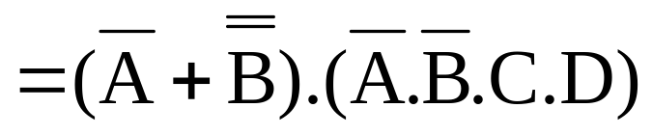
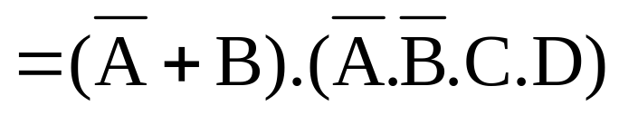
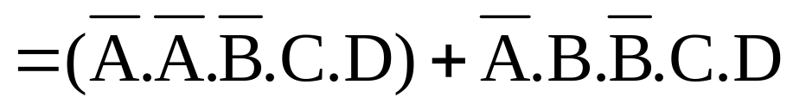
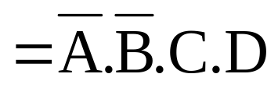
Simplifying Boolean Expression
Simplifying by applying Demorgan’s theorem
Notes:
Let us verify the analysis of the Logic Circuit by simplifying the original Boolean expression representing the Logic Circuit and obtaining the truth table of the simplifies expression.
The two truth tables should be identical
The expression is simplified to (AB*)* ANDed with (A*B*CD)** by applying Demorgan’s 2nd theorem
Applying Demorgan’s 1st theorem and Rule No. 9 to the two terms results in (A*OR B**) ANDed with (A*B*CD)
The term (A* OR B**) simplifies to (A* OR B)
Applying the Distributive law the expression simplifies to A*B*CD
The conditions A=0, B=0, C=1, D=1 are identical to the original expression that was analysed.

Slide 11
Truth Table of Simplified expression
Input |  |  |  | Output
A | B | C | D | F
0 | 0 | 0 | 0 | 0
0 | 0 | 0 | 1 | 0
0 | 0 | 1 | 0 | 0
0 | 0 | 1 | 1 | 1
0 | 1 | 0 | 0 | 0
0 | 1 | 0 | 1 | 0
0 | 1 | 1 | 0 | 0
0 | 1 | 1 | 1 | 0
1 | 0 | 0 | 0 | 0
1 | 0 | 0 | 1 | 0
1 | 0 | 1 | 0 | 0
1 | 0 | 1 | 1 | 0
1 | 1 | 0 | 0 | 0
1 | 1 | 0 | 1 | 0
1 | 1 | 1 | 0 | 0
1 | 1 | 1 | 1 | 0
Notes:
The truth table representing the function represented by the simplified expression is identical to the function represented by the truth table prepared earlier as a result of analysing the Boolean expression.

Slide 12
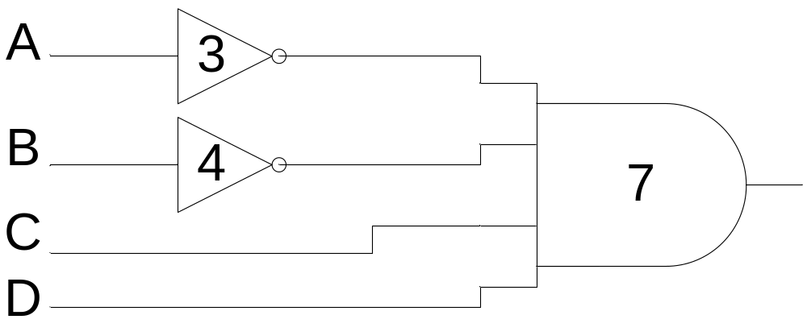
Simplified Logic Circuit

Slide 13
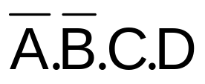
Simplified Logic Circuit
Simplified expression is in SOP form
Simplified circuit

Slide 14
Second Example
Evaluating Boolean Expression
Representing results in a Truth Table
Simplification of Boolean Expression results in POS form and requires 3 variables instead of the original 4
Representing results in a Truth Table
Verifying two expressions through truth tables

Slide 15
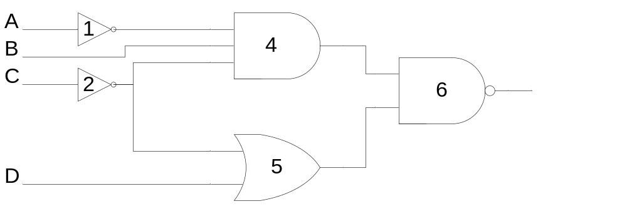
Analysis of Logic Circuits Example 2
Notes:
Consider the logic circuit implemented using NOT gates, AND gate, OR gate and NAND gate.
The circuit can be represented by a Boolean Expression.
Let us define the Boolean expression representing the logic circuit.
Starting from the left hand side of the circuit
Output of NOT gate 1 is A*
Output of NOT gate 2 is C*
Output of three input AND gate 4 is A*BC*
Output of two input OR gate 5 is C*+D
Output of two input NAND gate 6 is ((A*BC*)(C*+D))*

Slide 16
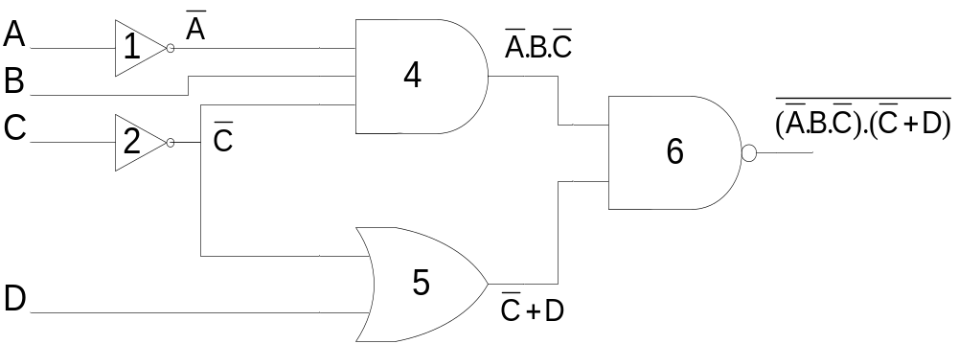
Analysis of Logic Circuits Example 2
Notes:
Consider the logic circuit implemented using NOT gates, AND gate, OR gate and NAND gate.
The circuit can be represented by a Boolean Expression.
Let us define the Boolean expression representing the logic circuit.
Starting from the left hand side of the circuit
Output of NOT gate 1 is A*
Output of NOT gate 2 is C*
Output of three input AND gate 4 is A*BC*
Output of two input OR gate 5 is C*+D
Output of two input NAND gate 6 is ((A*BC*)(C*+D))*

Slide 17
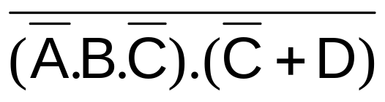
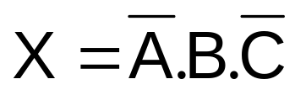
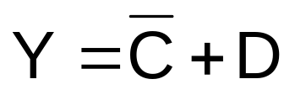
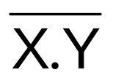
Evaluating Boolean Expression
The expression
Assume and
Expression
Conditions for output = 1 X=0 OR Y=0
Since
X=0 when A=1,B=0 or C=1
Since
Y=0 when C=1 and D=0
Notes:
Now consider the expression which has two terms
The term A*BC* and the term C*+D
Assume that the term A*BC* is represented by literal X
Also assume that the term C*+D is represented by the literal Y
Thus the expression is now represented as (XY)*
For which condition does the expression output a 1?
The expression shows that a NAND operation is being performed between terms X and Y.
Therefore when term X OR the term Y is 0, the output is a 1.
The term X=A*BC* is 0 when literal A*is 0 or A=1, literal B is zero or literal C*=0 or C=1.
The term Y=C*+D is 0 when literals C*=0 and D=0
Or when C=1 and D=0

Slide 18
Evaluating Boolean Expression & Truth Table
Conditions for o/p =1
(A=1,B=0 OR C=1) OR (C=1 AND D=0)
Input |  |  |  | Output
A | B | C | D | F
0 | 0 | 0 | 0 | 1
0 | 0 | 0 | 1 | 1
0 | 0 | 1 | 0 | 1
0 | 0 | 1 | 1 | 1
0 | 1 | 0 | 0 | 0
0 | 1 | 0 | 1 | 0
0 | 1 | 1 | 0 | 1
0 | 1 | 1 | 1 | 1
1 | 0 | 0 | 0 | 1
1 | 0 | 0 | 1 | 1
1 | 0 | 1 | 0 | 1
1 | 0 | 1 | 1 | 1
1 | 1 | 0 | 0 | 1
1 | 1 | 0 | 1 | 1
1 | 1 | 1 | 0 | 1
1 | 1 | 1 | 1 | 1
Notes:
Conditions for output =1 are
For the term A*BC* A=1 OR B=0 OR C=1
For the term C*+D C=1 AND D=0
The truth table outputs corresponding to the input conditions A=1, B=0 OR C=1 are marked as 1s
The truth table outputs corresponding to the input conditions C=1 AND D=0 are also marked as 1s

Slide 19
Rewriting the Truth Table
Conditions for o/p =1
(A=1,B=0 OR C=1) OR (C=1 AND D=0)
Input |  |  | Output
A | B | C | F
0 | 0 | 0 | 1
0 | 0 | 1 | 1
0 | 1 | 0 | 0
0 | 1 | 1 | 1
1 | 0 | 0 | 1
1 | 0 | 1 | 1
1 | 1 | 0 | 1
1 | 1 | 1 | 1
Notes:
The 4-variable truth table shows that for all input combinations of variables A, B, C and D the output only depends on the inputs A, B and C. D does not play any role in the function output.
For example for the input combination A=0, B=1, C=1 the output is 1 if D=0 or D=1. Similar is the case for other inputs.
Thus a simpler 3 variable K-Map can represent the same function as the 4 variable K-map.

Slide 20
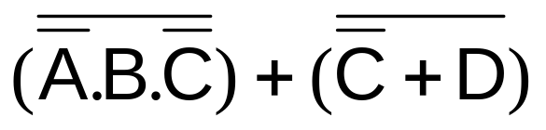
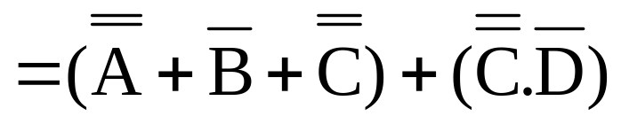
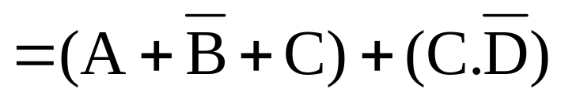
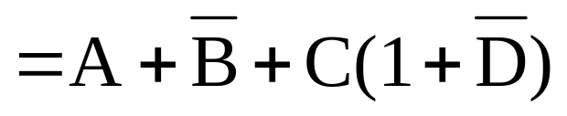
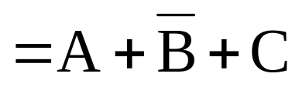
Simplifying Boolean Expression
Simplifying by applying Demorgan’s theorem
=
Notes:
Let us verify the analysis of the Logic Circuit by simplifying the original Boolean expression representing the Logic Circuit and obtaining the truth table of the simplifies expression.
The two truth tables should be identical
The expression is simplified to (A*BC*)* + (C*+D)* by applying Demorgan’s 1st theorem
Applying Demorgan’s 1st and 2nd theorems to the two terms respectively results in (A**+B*+C**) + (C**D*)
The expression simplifies to (A+B*+C) + CD*
Which simplifies to A+B*+C

Slide 21
Truth Table of Simplified expression
Input |  |  | Output
A | B | C | F
0 | 0 | 0 | 1
0 | 0 | 1 | 1
0 | 1 | 0 | 0
0 | 1 | 1 | 1
1 | 0 | 0 | 1
1 | 0 | 1 | 1
1 | 1 | 0 | 1
1 | 1 | 1 | 1
Notes:
The truth table representing the function represented by the simplified expression is identical to the function represented by the truth table prepared earlier as a result of analysing the Boolean expression.

Slide 22
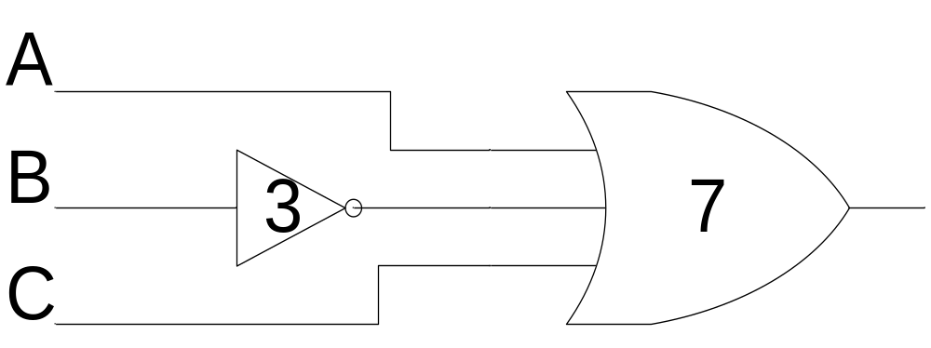
Simplified Logic Circuit

Slide 23
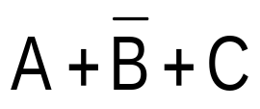
Simplified Logic Circuit
Simplified expression is in POS form representing a single Sum term
Simplified circuit

Slide 24
Standard forms of Boolean Expressions
Sum-of-Products form
Product-of-Sums form
Notes:
Sum-of-Product (SOP) form: When two or more product terms are summed by Boolean addition, the result is a Sum-of-Product or SOP expression
Product-of-Sum (POS) form: When two or more sum terms are multiplied by Boolean multiplication, the result is a Product-of-Sum or POS expression
The Domain of an SOP and POS expression is the set of variables contained in the expression, both complemented and un-complemented.
A SOP and POS expression can have a single variable term such as A
A SOP and POS expression can not have a term of more than one variable having an over bar extending over the entire term.

Slide 25
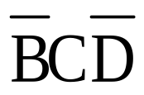
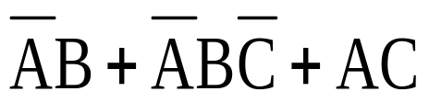
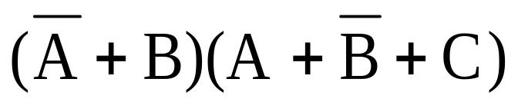
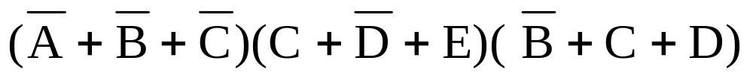
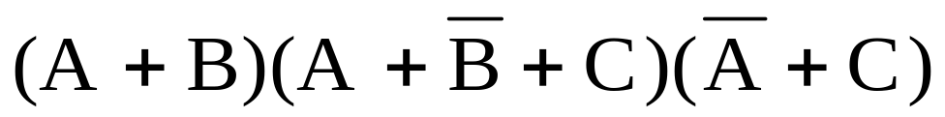
Standard forms of Boolean Expressions
Sum-of-Products form
AB + ABC
ABC + CDE +
Product-of-Sums form

Slide 26
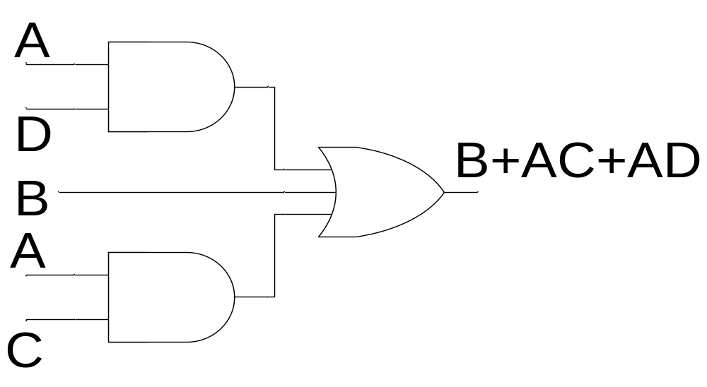
Implementation of SOP expression

Slide 27
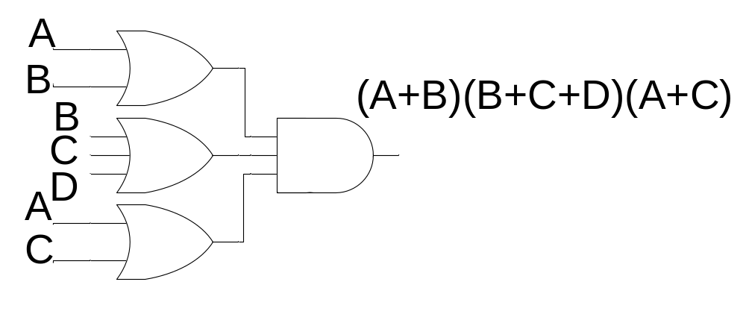
Implementation of POS expression

Slide 28
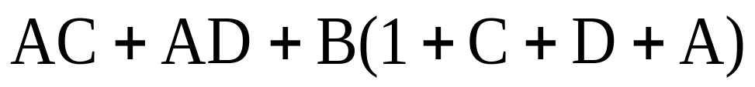
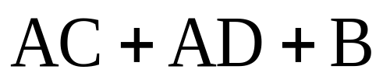
Conversion of general expression to SOP form
Notes:
Any logical expression can be converted into SOP form by applying techniques of Boolean Algebra

Slide 29
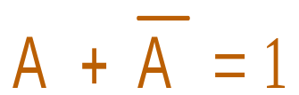
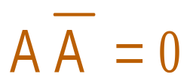
Standard SOP and POS form
Standard SOP and POS form has all the variables in all the terms
A non-standard SOP is converted into standard SOP by using the rule 6
A non-standard POS is converted into standard POS by using the rule 8

Slide 30
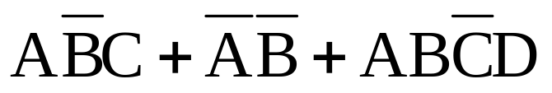
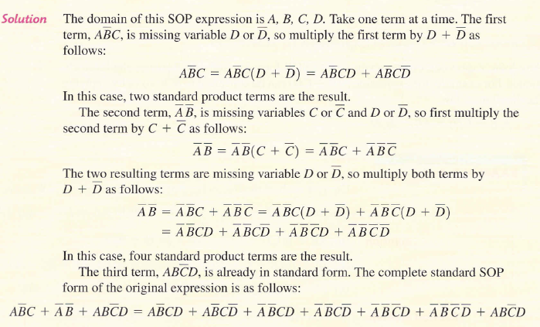
Standard SOP form
Notes:
A standard SOP form has product terms that have all the variables in the domain of the expression.
The SOP expression AC* +BC* is not a standard SOP as the domain of the expression has variables A, B and C.
To convert the non-standard SOP into a standard SOP the rule A+A*=1 is used
Applying the rule to expression AC* + BC* converts it into a standard SOP form ABC*+AB*C*+A*BC* each product term having the three variables A, B and C

Slide 31
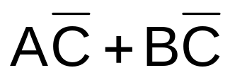
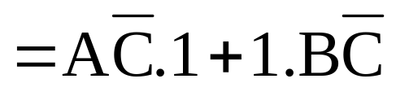
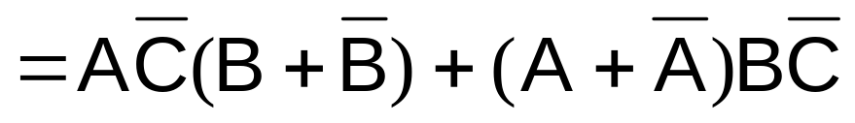
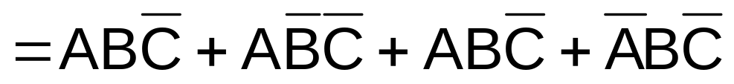
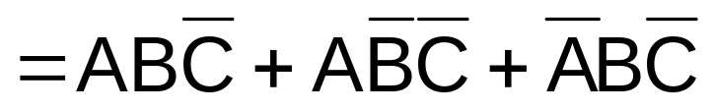
Standard SOP form
Notes:
A standard SOP form has product terms that have all the variables in the domain of the expression.
The SOP expression AC* +BC* is not a standard SOP as the domain of the expression has variables A, B and C.
To convert the non-standard SOP into a standard SOP the rule A+A*=1 is used
Applying the rule to expression AC* + BC* converts it into a standard SOP form ABC*+AB*C*+A*BC* each product term having the three variables A, B and C

Slide 32
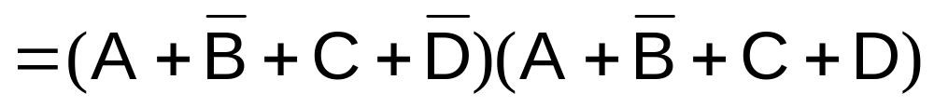
Standard POS form
Using rule 12: (A+B).(A+C) = A + B.C
Notes:
A standard POS form has sum terms that have all the variables in the domain of the expression.
The POS expression having the three sum terms (A+B*+C), (A+B+D*) and (A+B*+C*+D) is not a standard POS as the domain of the expression has variables A, B, C and D.
To convert the non-standard POS into a standard POS the rule AA*=0 is used
Applying the rule to expression converts it into a standard POS form each of the five sum terms having the four variables A, B, C and D

Slide 33
Standard POS form
Notes:
A standard POS form has sum terms that have all the variables in the domain of the expression.
The POS expression having the three sum terms (A+B*+C), (A+B+D*) and (A+B*+C*+D) is not a standard POS as the domain of the expression has variables A, B, C and D.
To convert the non-standard POS into a standard POS the rule AA*=0 is used
Applying the rule to expression converts it into a standard POS form each of the five sum terms having the four variables A, B, C and D

Slide 34
Why Standard SOP and POS forms?
Minimal Circuit implementation by switching between Standard SOP or POS
Constructing Truth tables
Alternate Mapping method for simplification of expressions
PLD based function implementation
Notes:
Any logic circuit can be implemented by using either the SOP, AND-OR combination of gates or POS, OR-AND combination of gates. It is very simple to convert from standard SOP to standard POS or vice versa. This helps in selecting an implementation that requires the minimum number of gates.
Secondly, the simplification of general Boolean expression by applying the laws, rules and theorems does not always result in the simplest form as the ability to apply all the rules depends on ones experience and knowledge of all the rules.
A simpler mapping method uses Karnaugh maps to simplify general expressions. Mapping of all the terms in a SOP form expression and the sum terms in a POS form can be easily done if standard forms of SOP and POS expressions are used. Karnaugh maps will be discussed latter in the chapter.
Lastly, the PLDs are implemented having a general purpose structure based on AND-OR arrays. A function represented by an expression in Standard SOP form can be readily programmed.

Slide 35
Minterms and Maxterms
Minterms: Product terms in Standard SOP form
Maxterms: Sum terms in Standard POS form
Binary representation of Standard SOP product terms
Binary representation of Standard POS sum terms

Slide 36
















Minterms and Maxterms & Binary representations
A | B | C | Min-terms | Max-terms
0 | 0 | 0
0 | 0 | 1
0 | 1 | 0
0 | 1 | 1
1 | 0 | 0
1 | 0 | 1
1 | 1 | 0
1 | 1 | 1

Slide 37
SOP-POS Conversion
Minterm values present in SOP expression not present in corresponding POS expression
Maxterm values present in POS expression not present in corresponding SOP expression

Slide 38
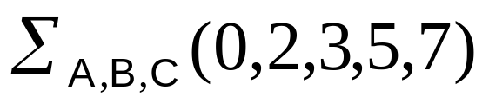
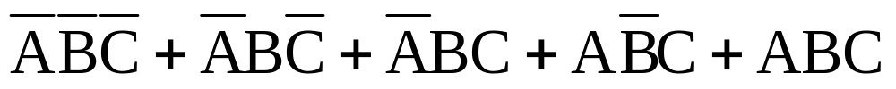
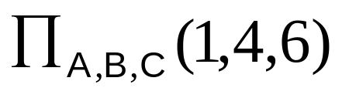
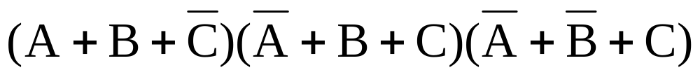
SOP-POS Conversion
Canonical Sum
Canonical Product
=
Notes:
The 5 sum term standard SOP expression has the binary values 000, 010,011,101 and 111.
The expression is represented in Canonical Sum form where the variables A,B and C define the domain of the expression. The numbers 0,2, 3, 5 and 7 represent the Minterms present in the SOP expression.
The missing binary values are 001, 100 and 110.
The equivalent POS expression has the corresponding missing 3 terms as sum terms 1, 4 and 6
The expression is represented in Canonical Product form where the variables A, B and C define the domain of the expression. The numbers 1, 4 and 6 represent the MAxterms present in the POS expression.
If the 3 sum terms are multiplied together and the expression is solved, it results in the 5 sum term SOP expression

Slide 39
Boolean Expressions and Truth Tables
Standard SOP & POS expressions converted to truth table form
Standard SOP & POS expressions determined from truth table

Slide 40



SOP-Truth Table Conversion
Input |  |  | Output
A | B | C | F
0 | 0 | 0
0 | 0 | 1
0 | 1 | 0
0 | 1 | 1
1 | 0 | 0
1 | 0 | 1
1 | 1 | 0
1 | 1 | 1
Notes:
The steps involved in representing a SOP expression in a truth table are to first convert the non-standard SOP expression into standard SOP expression.
In the next step the minterms present in the standard SOP expression are marked as 1s in the truth table output column.
The remaining minterms that are not present in the SOP expression are marked as 0s in the output column of the truth table.
A standard SOP can be determined from the truth table by writing out all the minterms marked by 1s in the output column of the truth table.

Slide 41
SOP-Truth Table Conversion
Input |  |  | Output
A | B | C | F
0 | 0 | 0
0 | 0 | 1
0 | 1 | 0
0 | 1 | 1 | 1
1 | 0 | 0 | 1
1 | 0 | 1 | 1
1 | 1 | 0
1 | 1 | 1 | 1
Notes:
The steps involved in representing a SOP expression in a truth table are to first convert the non-standard SOP expression into standard SOP expression.
In the next step the minterms present in the standard SOP expression are marked as 1s in the truth table output column.
The remaining minterms that are not present in the SOP expression are marked as 0s in the output column of the truth table.
A standard SOP can be determined from the truth table by writing out all the minterms marked by 1s in the output column of the truth table.

Slide 42
SOP-Truth Table Conversion
Input |  |  | Output
A | B | C | F
0 | 0 | 0 | 0
0 | 0 | 1 | 0
0 | 1 | 0 | 0
0 | 1 | 1 | 1
1 | 0 | 0 | 1
1 | 0 | 1 | 1
1 | 1 | 0 | 0
1 | 1 | 1 | 1
Notes:
The steps involved in representing a SOP expression in a truth table are to first convert the non-standard SOP expression into standard SOP expression.
In the next step the minterms present in the standard SOP expression are marked as 1s in the truth table output column.
The remaining minterms that are not present in the SOP expression are marked as 0s in the output column of the truth table.
A standard SOP can be determined from the truth table by writing out all the minterms marked by 1s in the output column of the truth table.

Slide 43


POS-Truth Table Conversion
Input |  |  | Output
A | B | C | F
0 | 0 | 0
0 | 0 | 1
0 | 1 | 0
0 | 1 | 1
1 | 0 | 0
1 | 0 | 1
1 | 1 | 0
1 | 1 | 1
Notes:
The steps involved in representing a POS expression in a truth table are to first convert the non-standard POS expression into standard POS expression.
In the next step the maxterms present in the standard POS expression are marked as 0s in the truth table output column.
The remaining maxterms that are not present in the POS expression are marked as 1s in the output column of the truth table.
A standard POS can be determined from the truth table by writing out all the maxterms marked by 0s in the output column of the truth table.

Slide 44
POS-Truth Table Conversion
Input |  |  | Output
A | B | C | F
0 | 0 | 0
0 | 0 | 1 | 0
0 | 1 | 0 | 0
0 | 1 | 1 | 0
1 | 0 | 0
1 | 0 | 1 | 0
1 | 1 | 0
1 | 1 | 1
Notes:
The steps involved in representing a POS expression in a truth table are to first convert the non-standard POS expression into standard POS expression.
In the next step the maxterms present in the standard POS expression are marked as 0s in the truth table output column.
The remaining maxterms that are not present in the POS expression are marked as 1s in the output column of the truth table.
A standard POS can be determined from the truth table by writing out all the maxterms marked by 0s in the output column of the truth table.

Slide 45
POS-Truth Table Conversion
Input |  |  | Output
A | B | C | F
0 | 0 | 0 | 1
0 | 0 | 1 | 0
0 | 1 | 0 | 0
0 | 1 | 1 | 0
1 | 0 | 0 | 1
1 | 0 | 1 | 0
1 | 1 | 0 | 1
1 | 1 | 1 | 1
Notes:
The steps involved in representing a POS expression in a truth table are to first convert the non-standard POS expression into standard POS expression.
In the next step the maxterms present in the standard POS expression are marked as 0s in the truth table output column.
The remaining maxterms that are not present in the POS expression are marked as 1s in the output column of the truth table.
A standard POS can be determined from the truth table by writing out all the maxterms marked by 0s in the output column of the truth table.

Slide 46

LOGIC OPERATIONS

Slide 47

LOGIC OPERATIONS

Slide 48
Karnaugh Map
Simplification of Boolean Expressions
  Doesn’t guarantee simplest form of expression
  Terms are not obvious
  Skills of applying rules and laws
K-map provides a systematic method
  An array of cells
  Used for simplifying 2, 3, 4 and 5 variable expressions

Slide 49
3-Variable K-map
Used for simplifying 3-variable expressions
K-map has 8 cells representing the 8 minterms and 8 maxterms
K-map can be represented in row format or column format

Slide 50
4-Variable K-map
Used for simplifying 4-variable expressions
K-map has 16 cells representing the 16 minterms and 8 maxterms
A 4-variable K-map has a square format

